Slide 1
INTRODUCTION
The first public mobile telephone system, known as Mobile Telephone System (MTS), was introduced in 1946
it suffered many limitations such as
the fact that transceivers were very big and
could be carried only by vehicles,
(b) inefficient way of spectrum usage and
(c) manual call switching.
IMTS (Improved Mobile Telephone System), was an improvement on MTS offering more channels and automatic call switching

Slide 2
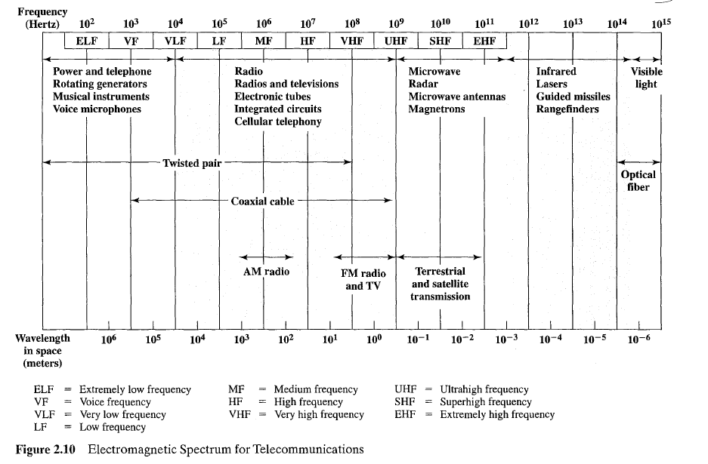

Slide 3
The era of cellular telephony as we understand it today began with the introduction of the First Generation of cellular systems (1G systems).
The major difference between 1G systems and MTS/IMTS was the use of the cellular concept in 1G, which brought about a revolution in the area of mobile telephony
The use of the cellular concept greatly improved spectrum usage
1G systems are considered primitive is due to the fact that they utilize analog signaling for user traffic

Slide 4
This leads to a number of problems:
No use of encryption.
The use of analog signaling does not permit efficient encryption schemes.
Therefore, 1G systems do not encrypt traffic.
Thus, voice calls through a 1G network are subject to easy eavesdropping.
Another problem is the fact that,
by listening to control channels, users’ identification numbers can be ‘stolen’ and used to place illegal calls, which are charged to the user.

Slide 5
2) Inferior call qualities.
Analog traffic is easily degraded by interference, which results in inferior call quality.
Contrary to digital traffic, no coding or error correction is applied in order to combat interference
3) Spectrum inefficiency.
In analog systems, each RF carrier is dedicated to a single user, regardless of whether the user is active (speaking) or not (idle within the call).
This is the reason for the inefficient spectrum usage compared to later generations of cellular systems.

Slide 6
2G systems overcome many of the deficiencies of 1G
Encryption.
Digitized traffic can be easily encrypted in order to provide privacy and security.
Encrypted signals cannot be intercepted and overheard by unauthorized parties (at least not without very powerful equipment).
On the other hand, powerful encryption is
not possible in analog systems, which most of the time transmit data without any protection.
Thus, digital systems provide an increased potential for securing the user’s traffic and preventing unauthorized network access.

Slide 7
2) Use of error correction.
In digital systems, it is possible to apply error detection and error correction techniques to the user traffic.
Using these techniques the receiver can detect and correct bit errors, thus enhancing transmission reliability.
This obviously leads to signals with little or no corruption, which of course translates into ……
(a) better voice call qualities,
(b) higher speeds for data applications, and
(c) efficient spectrum use,
since fewer retransmissions are bound to occur when error correction and error detection techniques are used.

Slide 8
3) Furthermore, digital data can be compressed, which increases the efficiency of spectrum use even more.
It is actually this increased efficiency that enables 2G systems to support
4) more users per base station per MHz of spectrum than 1G systems,
5) thus allowing operators to provide service in high-density areas more economically

Slide 9
In analog systems, each RF carrier is dedicated to a single user, regardless of whether the user is active (speaking) or not (idle within the call).
In digital systems each RF carrier is shared by more than one user, either by using different time slots or different codes per user.
Slots or codes are assigned to users only when they have traffic (either voice or data) to send.

Slide 10
Differing to 1G systems, which employ FDMA for user separation,
2G systems allow the use of…..
Time Division Multiple Access (TDMA) and
Code Division Multiple Access (CDMA) as well.

Slide 11
The use of TDMA or CDMA in cellular systems offers a number of advantages:
Natural integration with the evolving digital wire line network.
Flexibility for mixed voice/data communication and the support of new services.
Potential for further capacity increases as reduced rate speech coders are introduced.
Reduced RF transmit power (which obviously translates into increasing battery life in handsets).
Reduced system complexity (mobile-assisted handoffs, fewer radio transceivers).

Slide 12
2G systems are limited in terms of maximum data rate, it makes
2G systems practically useless for the increased requirements of future mobile applications
People will want to be able to use their mobile platforms for a variety of services, ranging from simple voice calls, web browsing and reading e-mail to video conferencing, real-time and bursty-traffic applications.

Slide 13
To realize the inefficiency of 2G systems for such applications, consider a simple transfer of a 2 MB presentation.
Such a transfer would take approximately 28 min employing the 9.6 kbps GSM data transmission.
It can be clearly seen that future services cannot be realized over the present 2G systems

Slide 14
Third generation (3G) mobile and wireless networks aim to fulfill the demands of future services.
3G systems will offer…
global mobile multimedia communication capabilities in a seamless and efficient
users will be able to use a single device in order to enjoy a wide variety of applications manner

Slide 15
Some key characteristics of 3G systems are
Support for both symmetric and asymmetric traffic.
Packet-switched and circuit-switched services support, such as Internet (IP) traffic and high performance voice services.
Support for running several services over the same terminal simultaneously.
Backward compatibility and system interoperability.
Support for roaming.
Ability to create a personalized set of services per user, which is maintained when the user moves between networks belonging to different providers.
This concept is known as the Virtual Home Environment (VHE)

Slide 16
3G Spectrum Allocation
ITU (International Telecommunication Union -1992)plays an important role in spectrum regulation
ITU licensed a guideline for worldwide IMT-2000 spectrum usage in parts around the 2 GHz band
All 3G systems would operate in the same frequency band,

Slide 17
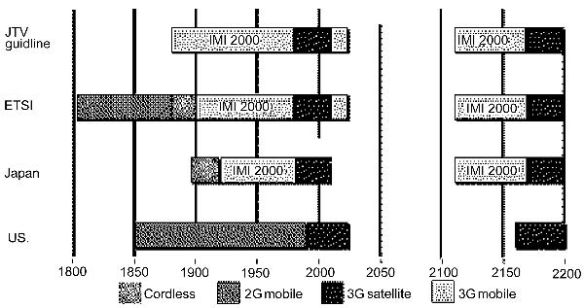

Slide 18
Third Generation Applications
1. Multimedia applications
-Video telephony and videoconferencing will be typical mobile multimedia applications
2. Mobile commerce applications
-Mobile commerce (m-commerce) is a subset of electronic
commerce (e-commerce).
-m-Commerce will introduce flexibility to e-commerce
-ability to make on-line purchases and reservations
-Market analysts prediction
3. Multimedia messaging applications
-Users will be able to use their 3G terminals to send and receive voice mails and notifications, video feed software applications and multimedia data files

Slide 19
4. Broadcasting applications
-Multimedia news broadcasting,
-interactive games and
-location-based information services, such as flight information in airports
5. Geo-location-based applications
-Two types of geo-location techniques,
one based on the handset and the other on the network
The first uses the GPS system to determine user location while in the second,
the replicas of the signals from the same handset at different base stations are combined in order to determine user location

Slide 20
Third Generation Standards
Standardization Activities: IMT-2000
In its present version, IMT-2000 aims to be an umbrella for a number of different systems.
This concept, known as the ‘family of systems’ concept was developed in order to ease convergence from existing 2G networks to 3G networks.

Slide 21
The Radio Access Network (RAN)
It comprises a set of interconnected base station controllers each one coordinating a set of base stations.
ITU decided not to define the protocol that will be used inside the RAN and the core network in order to allow for reuse of existing infrastructure and evolution of 2G-networks according to market needs.
The ITU will specify the Network-to-Network Interface (NNI), which is used to connect dissimilar core networks in order to provide roaming capabilities to users moving between cells belonging to different network families.

Slide 22
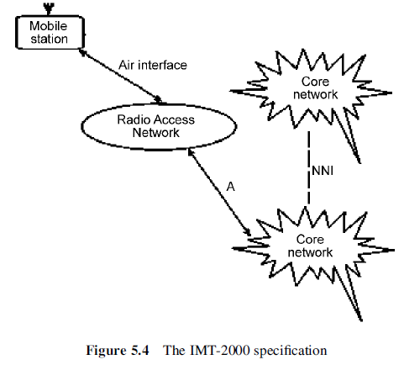

Slide 23
Radio Access Standards
The European Telecommunications Standards Institute (ETSI) proposal, also known as the
=>Universal Mobile Telecommunications System (UMTS),
=>calls for use of Wideband CDMA, (WCDMA) as the radio
access method.
=>The proposal consisted of two WCDMA modes.
This dual mode for certain frequency bands in Europe are ……
to be used either for uplink or downlink traffic (paired bands) or for both types of traffic using timesharing (unpaired bands).
Thus, ETSI’s proposal consisted of
Frequency Division Duplex(FDD) WCDMA for paired bands and
Time Division Duplex (TDD) WCDMA for unpaired bands.

Slide 24
The Association of Radio Industry Board (ARIB), the SDO in Japan, also proposed WCDMA.
The proposal made by ARIB is compatible with that of ETSI.
The United States Telecommunications Industry Association (TIA) made a three-fold proposal:
1. UWC-136,
2. A TDMA-based system which is an evolution of
IS-136,
3. Cdma2000 as the evolution of IS-95 and
a WCDMA system called WIMS.
The US T1P1 proposed WCDMA-NA, a FDD WCDMA system

Slide 25
A third-generation TDMA standard being developed for GSM/IS-136 evolution. This is called EDGE/UWC-136.
A single third-generation CDMA standard with three options:
(i) a direct-sequence option based on WCDMA;
(ii) a multicarrier option based on cdma2000; and
(iii) a TDD direct sequence mode based on TD-WCDMA

Slide 26
EDGE stands for Enhanced Data Rates for GSM Evolution
It is the only IMT-2000 air interface standard based on TDMA technology.
In its initial stages, EDGE was not supposed to be a competitor for the CDMA-based 3G standards.
Using the same bandwidth and channel structure as GSM,
its original purpose was to be the next upgrade for networks supporting GPRS and HSCSD.

Slide 27
Phase 1 emphasizes……….
the increased capacity and spectral efficiency by adopting……..
enhanced packet-switched mode and
an enhanced circuit-switched mode
that offer data rates up to 473 and 64 kbps, respectively.
In GSM systems, these modes are referred to as 1. Enhanced GPRS (EGPRS) and
2. Enhanced Circuit Switched Data (ECSD).
In a IS-136 system, high speed data services are referred to as EGPRS-136HS.

Slide 28
Phase 2 will aim…..
to provide support for QoS,
real-time and packet-switched voice services as
well as
interfacing to an all-IP core network
EDGE is the only candidate to offer support for 3G
services in such situations
The increased performance of EDGE is attributed to modulation techniques of higher level than those of GSM

Slide 29
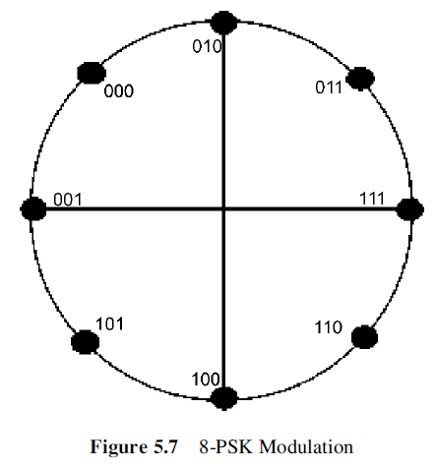
The Gaussian Minimum Shift Keying (GMSK) modulation of GSM, EDGE also uses the modulation scheme shown in Figure 5.7, which is known as eight-phase shift keying (8-PSK).

Slide 30
In 8-PSK, every transmitted symbol can have
eight possible values.
It can thus encode three bits per-symbol instead of the one bit per symbol encoding achieved by GMSK.
EDGE maintains the burst format of GSM

Slide 31
EDGE Classic and EDGE Compact
EDGE development for IS-136 based systems
comprises two modes: Compact and Classic.
EDGE Compact
Uses a new 200 kHz control channel structure
By means of base station synchronization and use of a 1/3 frequency reuse pattern, EDGE Compact can be deployed even in only 600 kHz of available bandwidth

Slide 32
EDGE Classic,
maintains the traditional GSM control-channel structure used by the ETSI standard with a 4/12 reuse pattern
uses the same channel structure as GSM, which typically uses a 4/12 frequency reuse pattern for carriers containing broadcast control channels and a 3/9 pattern for traffic channels.

Slide 33
MULTIPLEXING
To make efficient use of the transmission system, it is desirable to carry multiple signals on a single medium. This is referred to as multiplexing.
There are n inputs to a multiplexer.
The multiplexer is connected by a single data link to a de-multiplexer.
The link is able to carry n separate channels of data.
The de-multiplexer accepts the multiplexed data stream, separates (de-multiplexes) the data according to channel, and delivers them to the appropriate
output lines.

Slide 34
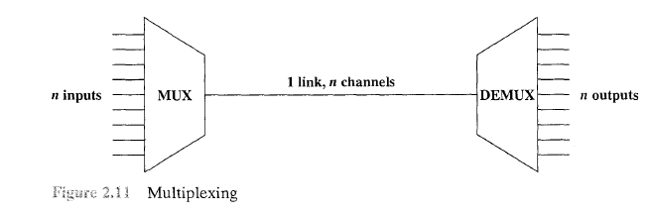

Slide 35
FEATURES
The higher the data rate,
the more cost effective the transmission facility.
increase in the data rate of the transmission facility
Most individual data communicating devices require relatively modest data rate support
Two techniques for multiplexing
frequency division multiplexing (FDM) and
time division multiplexing (TDM)

Slide 36
Each signal requires a certain bandwidth centered on its carrier frequency, referred to as a channel.
To prevent interference, the channels are separated by guard bands, which are unused portions of the spectrum

Slide 37
Time Division Multiplexing (TDM)
TDM takes advantage of the fact that the achievable bit rate (sometimes, unfortunately, called bandwidth) of the medium exceeds the required data rate of a digital signal.
Multiple digital signals can be carried on a single transmission path by interleaving portions of each signal in time.
The interleaving can be at the bit level or in blocks of bytes or larger quantities.
Analogously to FDM, the sequence of time slots dedicated to a particular source is called a channel.
One cycle of time slots (one per source) is called a frame.

Slide 38
An important parameter in any transmission system is the signal strength. As a signal propagates along a transmission medium, there will be a loss, or attenuation, of signal strength.
To compensate, amplifiers may be inserted at various points to impart a gain in signal strength.
It is customary to express gains, losses, and relative levels in decibels because…….
1) Signal strength often falls off exponentially, so loss is easily expressed in terms of the decibel, which is a logarithmic unit.
2) The net gain or loss in a cascaded transmission path can be calculated with simple addition and subtraction.

Slide 39
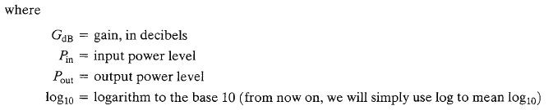
The decibel is a measure of the ratio between two signal levels. The decibel gain is given by

Slide 40

If the value of GdB is positive, this represents an actual gain in power.
If the value of GdB is negative, this represents an actual loss in power
For example, a gain of 3 dB means that the power has doubled.
a gain of - 3 dB means that the power has halved, and this is a loss of power.
a decibel loss as

Slide 41


Slide 42
Local area networks (LANs),
Metropolitan area networks (MANs), and
Wide area networks (WANs)
Wide area networks (WANs)
It consists of a number of interconnected switching nodes
A transmission from anyone device is routed through these internal nodes to the specified
destination device.
relatively modest capacity to subscribers

Slide 43
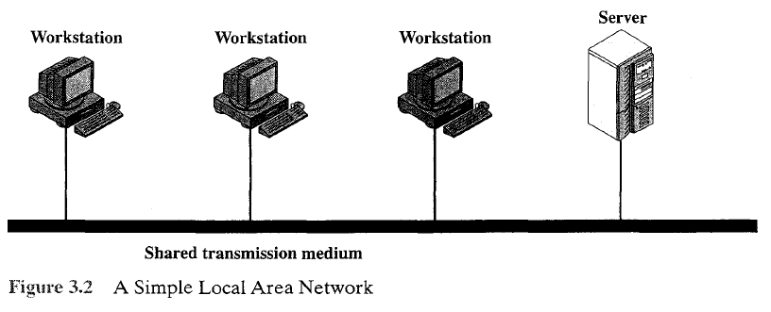
Local area networks (LANs)
The scope of the LAN is small, typically a single building or a cluster of buildings
The internal data rates of LANs are typically much greater than those ofWANs
Traditional LANs have provided data rates in a range from about 1 to 20 Mbps

Slide 44
Metropolitan Area Network
a MAN occupies a middle ground between LANs and WANs
MANs cover greater distances at higher data rates than LANs, although there is some overlap in geographical coverage
A MAN is intended to provide the required capacity at lower cost and greater efficiency than obtaining an equivalent service from the local telephone company.

Slide 45
Switching Techniques
For transmission of data beyond a local area, transmitting data from source to destination through a network of intermediate switching nodes, this switched network design
These are not concerned with the content of the data; rather their purpose is to provide a switching facility that will move the data from node to node until they reach their destination
The end devices may be referred to as stations.
Ex- computers, terminals, telephones, or other communicating devices.

Slide 46
Switching devices whose purpose is to provide communication refers to as nodes.
The nodes are connected to each other in some topology by transmission links.
Each station attaches to a node, and the collection of nodes is referred to as a communication network.

Slide 47
Circuit switching has been the dominant technology for both voice and data communications.
Communication via circuit switching implies that there is a dedicated communication path between two stations.
That path is a connected sequence of links between network nodes. i. e. resources within the network are dedicated to a particular call
On each physical link, a channel is dedicated to the connection.
The most common example -the telephone network.(voice traffic)

Slide 48
Packet-Switching
Data are transmitted in blocks, called packets.
packet length is 1000 octets (bytes).
Line efficiency is greater
can carry out data-rate conversion
When traffic becomes heavy, packets are still accepted, but delivery delay increases.
Priorities can be used.

Slide 49
Concept of Spread Spectrum
The spread spectrum technique was developed initially for military and intelligence requirements.
The essential idea is to spread the information signal over a wider bandwidth to make jamming and interception more difficult.
The first type of spread spectrum developed is known as frequency hopping.
A more recent type of spread spectrum is direct sequence.

Slide 50
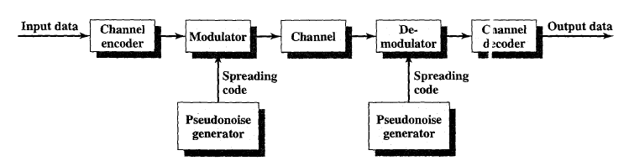
Figure 7.1 highlights the key characteristics of any spread spectrum system.

Slide 51
Input is fed into a channel encoder that produces an analog signal with a relatively narrow bandwidth around some center frequency.
This signal is further modulated using a sequence of digits known as a spreading code or Spreading sequence
the spreading code is generated by a pseudo-noise, or pseudorandom number, generator
The effect of this modulation is to increase
significantly the bandwidth (spread the spectrum) of the signal to be transmitted.

Slide 52
On the receiving end, the same digit sequence is used to demodulate the spread spectrum signal.
Finally, the signal is fed into a channel decoder to recover the data.

Slide 53
Several things can be gained from this apparent waste of spectrum
We can gain immunity from various kinds of noise and multipath distortion.
It can also be used for hiding and encrypting signals.
Only a recipient who knows the spreading code can recover the encoded information
Several users can independently use the same higher bandwidth with very little interference.
This property is used in cellular telephony applications, with a technique know as code division multiplexing (CDM) or code division multiple access (CDMA).

Slide 54
FREQUENCY HOPPING SPREAD SPECTRUM {FHSS}
Frequency hopping spread spectrum (FHSS) is a method of transmitting radio signals by shifting carriers across numerous channels with pseudorandom sequence which is already known to the sender and receiver.
It is defined in the 2.4 GHz band and
operates in around 79 frequencies
ranging from 2.402 GHz to 2.480 GHz.
Every frequency is GFSK modulated with channel width of 1MHz and rates defined as 1 Mbps and 2 Mbps respectively.

Slide 55
The receiver has the ability to hop its frequency across a specified bandwidth many times per second,
transmitting using one particular frequency for a specific time frame,
then hopping to yet another frequency and transmitting again
Advantages:
Eavesdropper can hear only unintelligible blips
Attempts to jam the signal on one frequency successed only at knocking out few bits

Slide 56
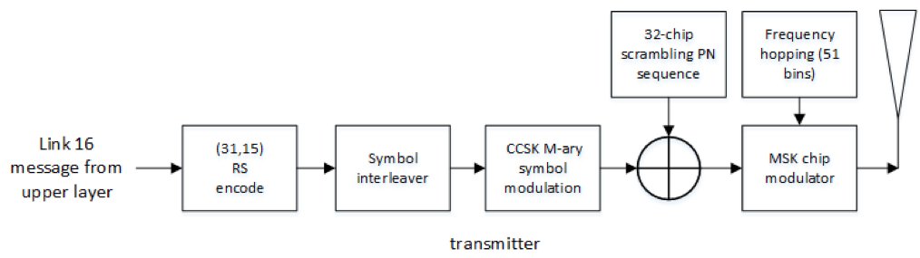

Slide 57
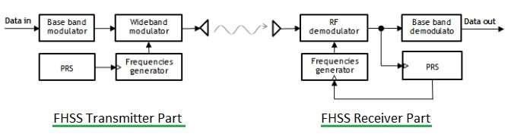

Slide 58
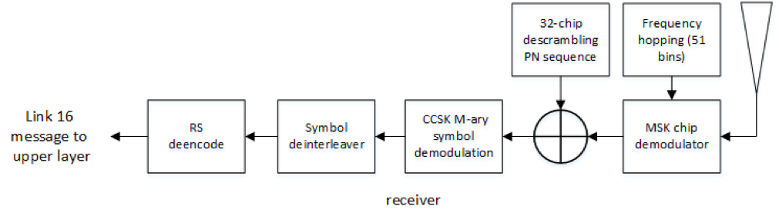

Slide 59
Direct Sequence Spread Spectrum (DSSS)
Used in local area wireless network transmissions
A data signal at the sending station is combined with a high data rate bit sequence, which divides user data based on a spreading ratio.
The benefits of using DSSS are…..
resistance to jamming,
sharing single channels among multiple users,
less background noise and
relative timing between transmitter and receivers.
This term is also known as direct sequence code division multiple access.

Slide 60
DSSS is a spread spectrum modulation technique used for digital signal transmission over airwaves.
developed for military use, and employed difficult-to-detect wideband signals to resist jamming attempts.
It is also being developed for commercial purposes in local and wireless networks.

Slide 61
The stream of information in DSSS is divided into small pieces, each associated with a frequency channel across spectrums.
Data signals at transmission points are combined with a higher data rate bit sequence, which divides data based on a spreading ratio.
The chipping code in a DSSS is a redundant bit pattern associated with each bit transmitted.
This helps to increase the signal's resistance to interference.
If any bits are damaged during transmission, the original data can be recovered due to the redundancy of transmission.

Slide 62
The entire process is performed by multiplying a radio frequency carrier and a pseudo-noise (PN) digital signal.
The PN code is modulated onto an information signal using several modulation techniques such as quadrature phase-shift keying (QPSK), binary phase-shift keying (BPSK), etc.

Slide 63
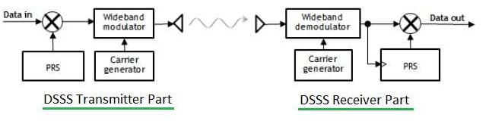
PRS =Pseudo-Random Sequence

Slide 64
Media Access Control layer (MAC layer)
In the Open Systems Interconnection (OSI) model of communication, the Media Access Control layer is one of two sublayers of the Data Link Control layer and is concerned with sharing the physical connection to the network among several computers.
Each computer has its own unique MAC address
The Media Access Control (MAC) data communication Networks protocol sub-layer, also known as the Medium Access Control, is a sub-layer of the data link layer specified in the seven-layer OSI model.

Slide 65
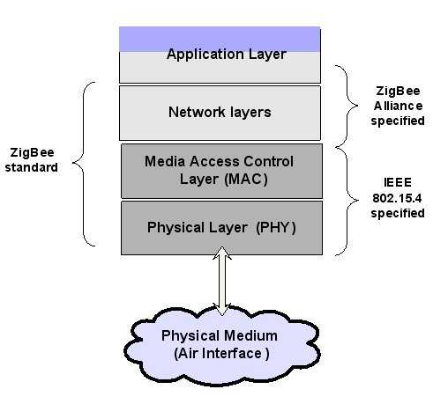

Slide 66
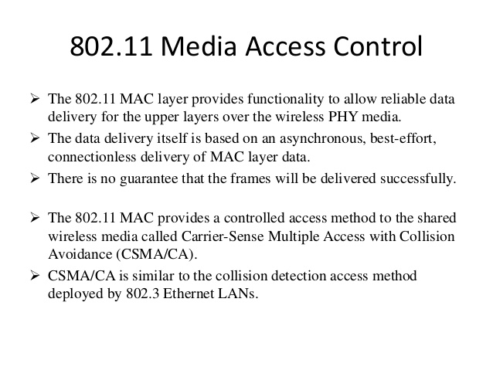

Slide 67
